Slide 1
Dr.M.P.Lal Professor and Head Department of Surgery
VENOUS DISEASES

Slide 2
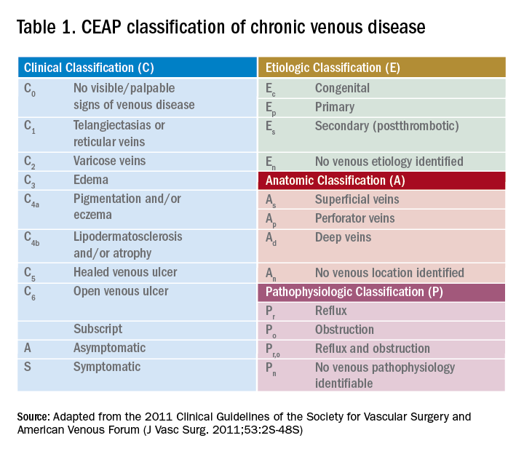

Slide 3
VARICOSE VEINS
DEFINITION
Dilated, tortuous and elongated superficial veins of the limb are called varicose veins

Slide 4
VARICOSE VEINS
Examples of varicosity
• Long saphenous varicosity
• Short saphenous varicosity
• Oesophageal varices and fundal varices
• Haemorrhoids

Slide 5
VARICOSE VEINS
PRIMARY VARICOSE VEINS
occur as a result of congenital weakness in the vein wall
SECONDARY VARICOSE VEINS
Pregnancy and pelvic tumours cause proximal obstruction to the blood flow.
Pills ( oral contraceptive pills) alter the viscosity of blood.
Progesterones dilate vessel wall.

Slide 6
VARICOSE VEINS
TESTS FOR VARICOSE VEINS AND INFERENCE
• Cough impulse test: Saphenofemoral incompetence
• Trendelenburg I: SF incompetence
Trendelenburg II: Perforator incompetence
• Multiple tourniquet test: Site of perforator incompetence
• Schwartz test: Superficial column of blood
• Modified Perthes' test: Deep vein thrombosis
• Fegan's test: To locate the perforators in the deep fascia

Slide 7
DEEP VEIN THROMBOSIS (DVT)
CAUSES OF DEEP VEIN THROMBOSIS
Trauma-injury to the vessel wall
Hormones-increased coagulability
Road traffic accidents
Operations-cholecystectomy
Malignancy-sluggish blood flow
Blood disorders-polycythaemia
Orthopaedic surgery, obesity, old age
Serious illness-stroke, Ml
Immobilisation
Splenectomy

Slide 8
MANAGEMENT of varicose veins
The following changes may help prevent varicose veins from forming or becoming worse:
Avoid standing for extended periods of time.
Lose weight or maintain a healthy weight.
Exercise to improve your circulation.
Use compression socks or stockings

Slide 9
MANAGEMENT
Currently, a wide variety of minimally invasive treatment options for varicose veins are available. These include:
sclerotherapy, using a liquid or foam chemical injection to block off a larger vein
microsclerotherapy, using a liquid chemical injection to block off smaller veins
laser surgery, using light energy to block off a vein
endovenous ablation therapy, using heat and radiofrequency waves to block off a vein
endoscopic vein surgery, using a small lighted scope inserted through a small incision to block off a vein

Slide 10
HOMOEOPATHIC MANAGEMENT
Arnica montana. Relieves pain, bruising and swelling associated with trauma, surgery or overexertion.
Calcarea carbonica. Varicose veins that hurt while the person is standing or walking may respond to this remedy.
Carbo vegetabilis.
Hamamelis.
Pulsatilla.
Lycopodium.
Zincum metallicum.
Lachesis

